Slide 1
Flow Visualization
Integral Surfaces

Slide 2
Flow Visualization: Geometry-Based Methods
Integral surfaces in time-dependent flows:
Stream surfaces
Path surfaces
Streak surfaces
Time surfaces

Slide 3
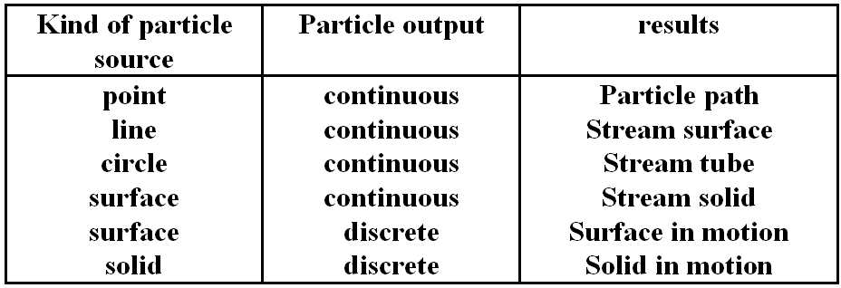
Flow Visualization: Geometry-Based Methods
Stream surfaces and stream objects:
Combination of different particle sources leads to different views of the flow.
Stream surfaces
Surfaces in the flow field which are tangent to the velocity field in each point.
Stream objects
Solids defined by their surfaces; these surfaces are given by particle paths.

Slide 4
Flow Visualization: Geometry-Based Methods
Stream Surface Integration:
seeding line: polygon
apply one step of stream line integration for each vertex of the polygon
➔ creates new polygon
triangulate strip between the two polygons
adaptively remove/insert points on polygon

Slide 5
Flow Visualization: Geometry-Based Methods

Slide 6
Flow Visualization: Geometry-Based Methods

Slide 7
Flow Visualization: Geometry-Based Methods

Slide 8
Flow Visualization: Geometry-Based Methods

Slide 9
Flow Visualization: Geometry-Based Methods
combination of particle sources
( Stolk/van Wijk, 1992): a) stream surface, b) stream tube, c) stream object in motion

Slide 10
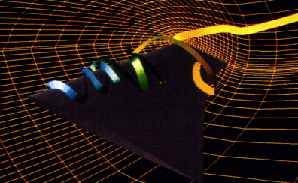
Flow Visualization: Geometry-Based Methods
Flow Ribbons
Very small stream surface (2 neighboring stream lines)
Idea: represent particle path and additional information by a ribbon

Slide 11
Flow Visualization: Geometry-Based Methods
Show in Amira
Flow Ribbons
Stream Surface

Slide 12
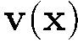
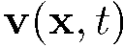

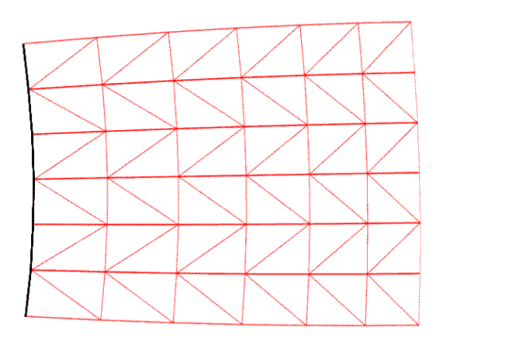
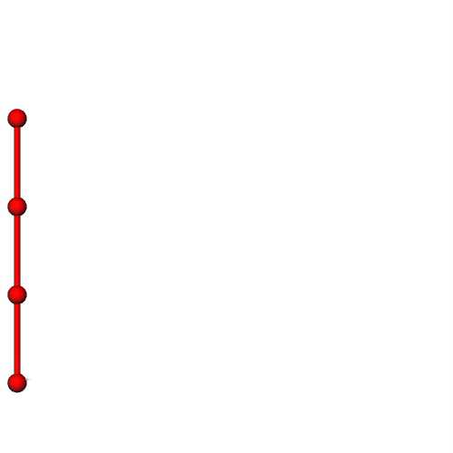
very important
steady vector field
unsteady vector field
stream surface
path surface
time
streak surface
General stream surfaces
[Hultquist, Vis 1992]
Topological considerations
[Stalling, Phd thesis, 1998]
High accuracy
[Garth et al., Vis 2008]

Slide 13
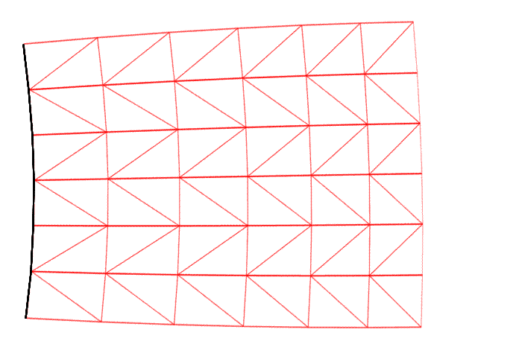
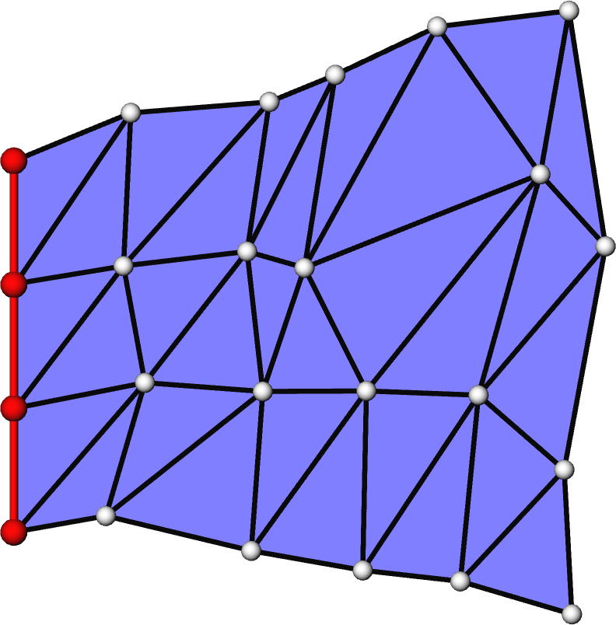
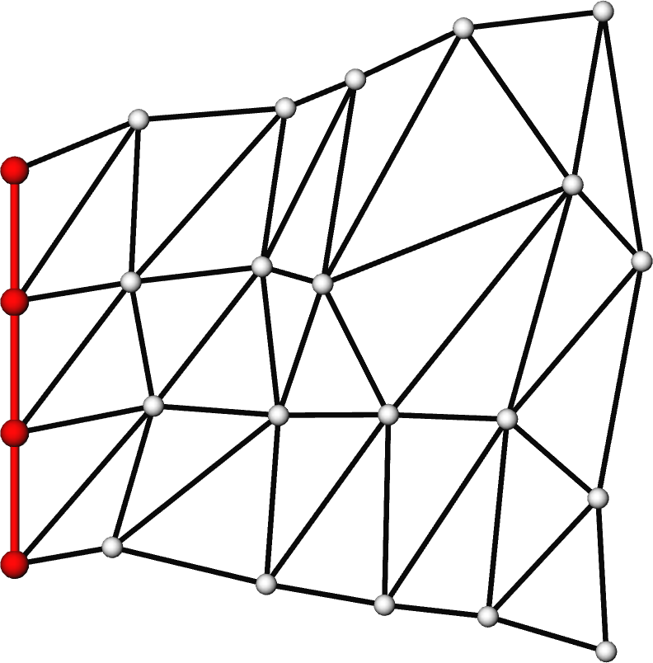
very important
Adaptive insertion/removal of points at front line
Euclidean distance
Angle
…
stream & path surfaces
streak surfaces
Complete remeshing in every time step is necessary to stay within resolution constraints

Slide 14
very important
Integrating a stream/path/streak/time line/surface means to look at the following subspaces of a 3D unsteady flow (which itself is 4D):
 | …line | …surface
Stream… | 1D (line) | 2D (surface)
Path… | 1D (line) | 2D (surface)
Streak… | 2D (surface) | 3D (volume)
Time… | 2D (surface) | 3D (volume)

Slide 15
Flow Visualization
Image-Based Methods
(integration-based)

Slide 16
Flow Visualization: Image-Based Methods
Spot Noise (Jarke van Wijk, Siggraph 1991)
distribute a set of intensity functions (spots) over domain
each spot represents a particle warped over a small time step
streak in the direction of local flow from where the particle is seeded

Slide 17
Flow Visualization: Image-Based Methods
Spot Noise
Different textures can be created using different spot shapes
Aligning the shape of the spot with the direction of flow gives a good visualization effect:
In direction of flow, scale proportional to (1 + |v|), where |v| = velocity magnitude
At 90 degrees to flow, scale proportional to 1 / (1 + |v|)

Slide 18
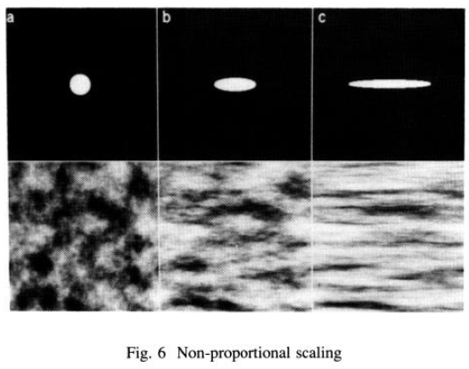
Flow Visualization: Image-Based Methods
Spot Noise
Different textures can be created using different spot shapes

Slide 19
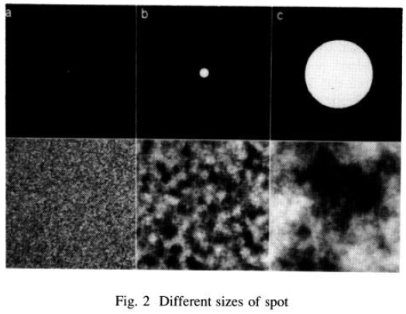
Flow Visualization: Image-Based Methods
Spot Noise
Different textures can be created using different spot sizes

Slide 20
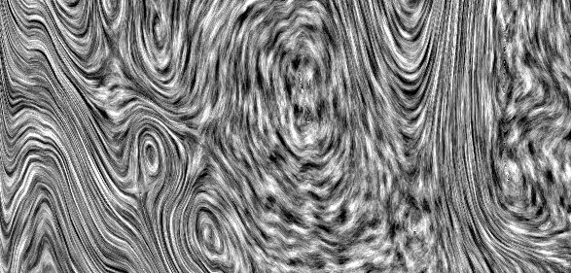
Flow Visualization: Image-Based Methods
Spot Noise
The velocity of the flow is encoded in the length of the streaks used to smear the texture.

Slide 21
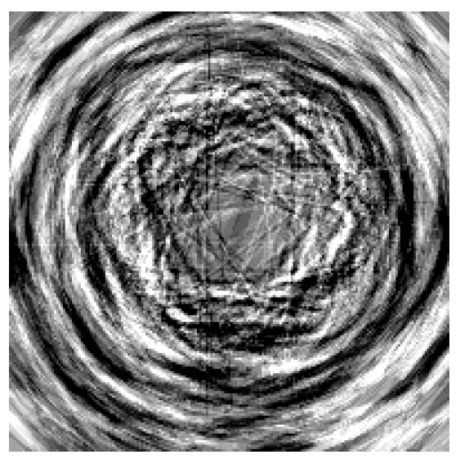
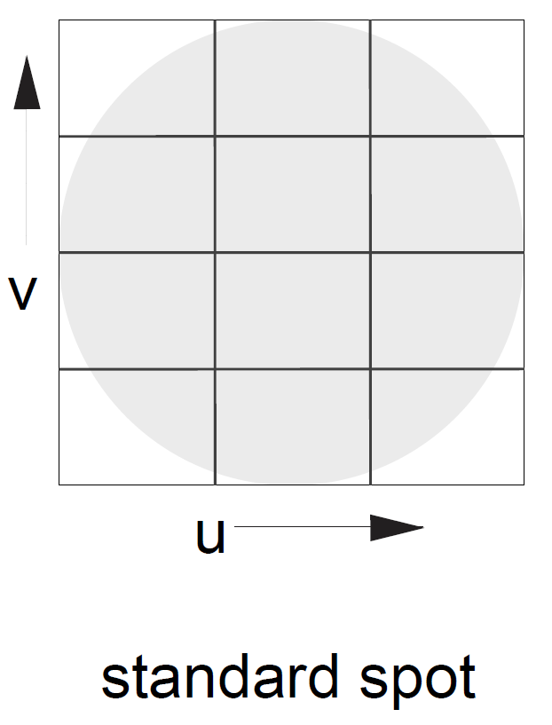
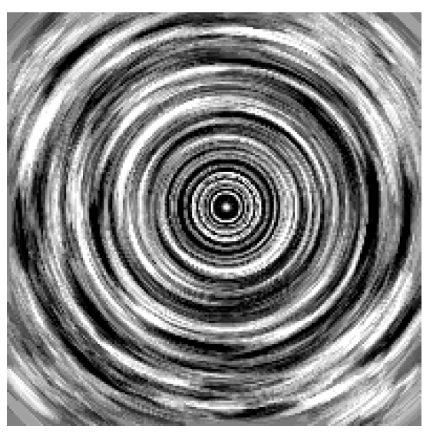
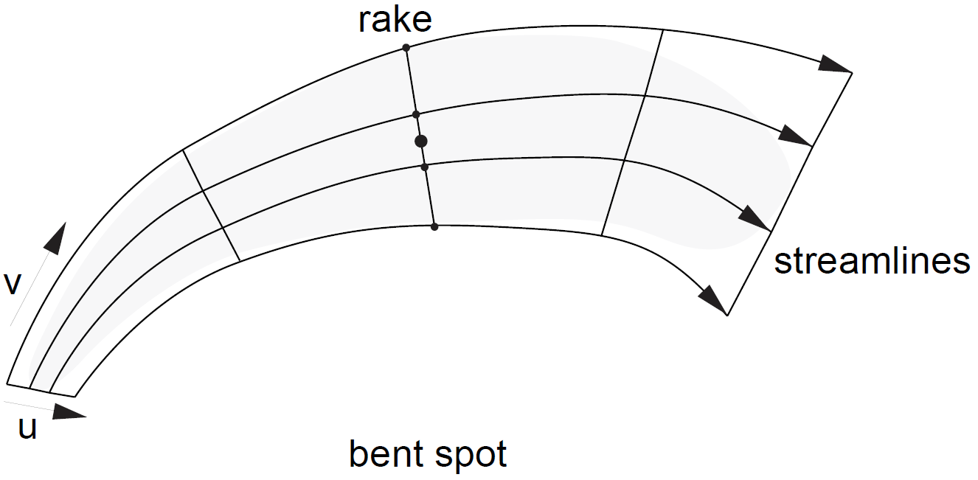
Flow Visualization: Image-Based Methods
Enhanced Spot Noise
Problem: The spot influences a region in the texture while its shape is based on data at a single point. If the velocity varies strongly over this region, the shape of the spot does not reflect the data properly.
Solution: Bend and deform spot following streamlines
de Leeuw & van Wijk, Vis 1995
standard spot noise
enhanced spot noise

Slide 22
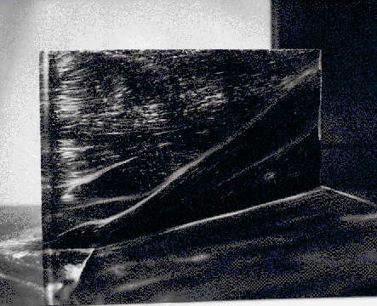
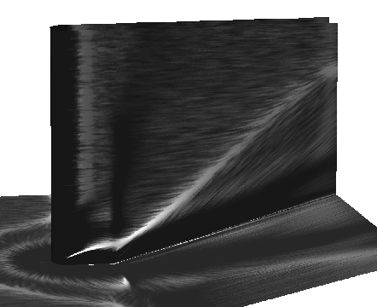
Flow Visualization: Image-Based Methods
Spot Noise: Relation to real-world experiments
Numerical simulation
of flow, visualized
using spot noise
Wall friction displayed
using oil and paint - wind
evaporates oil and paint
leaves white traces

Slide 23
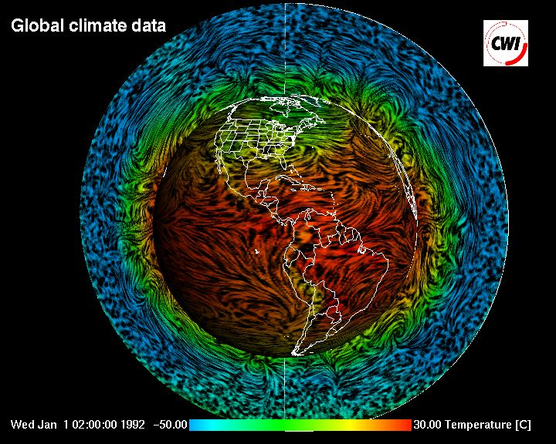
Flow Visualization: Image-Based Methods

Slide 24
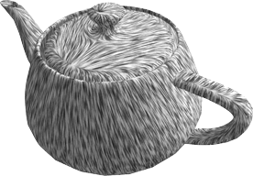
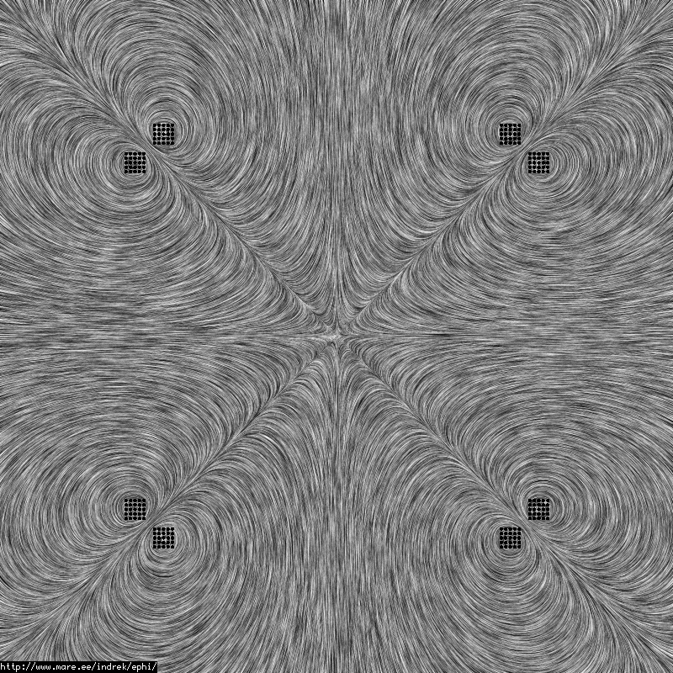
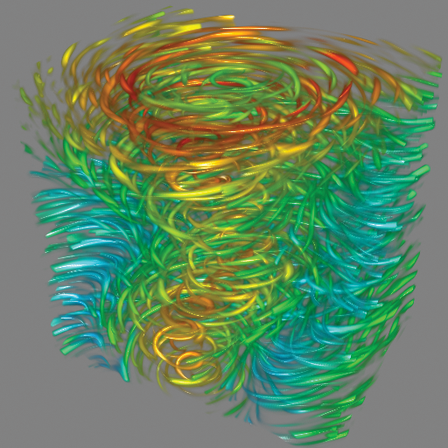
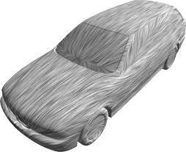
Line Integral Convolution
very important
LIC – Line Integral Convolution (Cabral/Leedom, Siggraph 1993)
A global method to visualize vector fields
2D vector field
vector field on surface
(often called 2.5D)
3D vector field

Slide 25
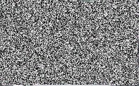
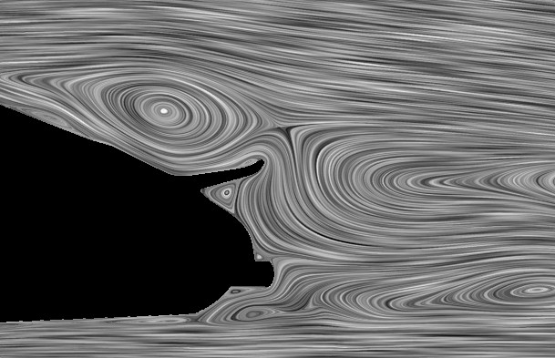
Line Integral Convolution
Idea of Line Integral Convolution (LIC)
Global visualization technique; uses stream lines
Start with a random texture
Smear out this texture along the stream lines in a vector field
Results in
low correlation of intensity values between neighboring lines,
but high correlation along them

Slide 26
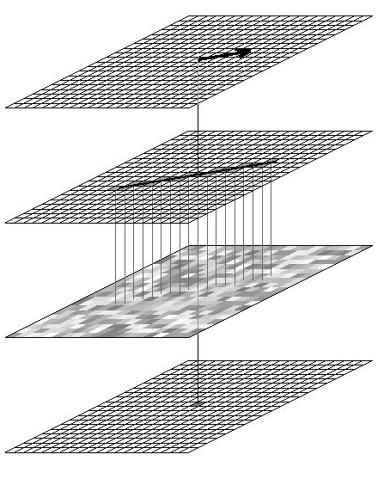
Line Integral Convolution
Algorithm for 2D LIC
Convolve a random texture along the stream lines
vector field
stream line
input texture
output image

Slide 27
Line Integral Convolution
Algorithm for 2D LIC
Let t → Φ0(t) the stream line containing the point (x0,y0)
T(x,y) is the randomly generated input texture
Compute the pixel intensity as:
Kernel:
Finite support [-L,L]
Normalized
Symmetric
convolution of the input texture T along the stream line Φ0(t) with a kernel k(t), which has a length of 2*L.
kernel
k(t)
-L
L

Slide 28
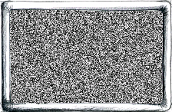
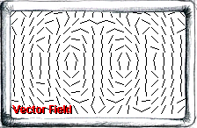
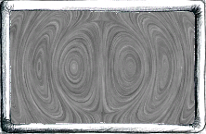
Line Integral Convolution
Input texture
(noise)
Vector field
kernel
k(t)
Convolution
-L
L
Final image

Slide 29
Line Integral Convolution
Technical details:
Rasterization of the stream line
Type of kernel
Length of kernel
Contrast
Performance
Reproducibility

Slide 30
Line Integral Convolution
Technical details: Rasterization of the stream line

Slide 31
Line Integral Convolution
Technical details: Rasterization of the stream line
How to do it?
Consider aliasing?
 |  |  |  |  |  |  |  |  |  | ?
 |  | ? |  |  |  |  |  |  |  | ?
 |  |  |  |  |  | ? | ?
 |  |  |  |  |  |  |  | ?
 | ?
Notes:
How => Bresenham could be used
But what would we do with pixels that are only covered half?

Slide 32
Line Integral Convolution
Technical details: Rasterization of the stream line
Easiest way: sample the arc-length-parameterized stream line equidistantly & evaluate the random texture as a bilinear scalar field
The step size of the integrator should be the min(width, height) of a pixel

Slide 33
Line Integral Convolution
Technical details: Type of kernel
Gaussian kernel
Triangle kernel
Box kernel
Result is the arithmetic mean of all collected pixel values.
kernel
k(t)
-L
L

Slide 34
Line Integral Convolution
Technical details: Length of kernel
Longer kernel leads to longer lines, and less contrast
Smaller kernel leads to shorter lines, and more contrast

Slide 35
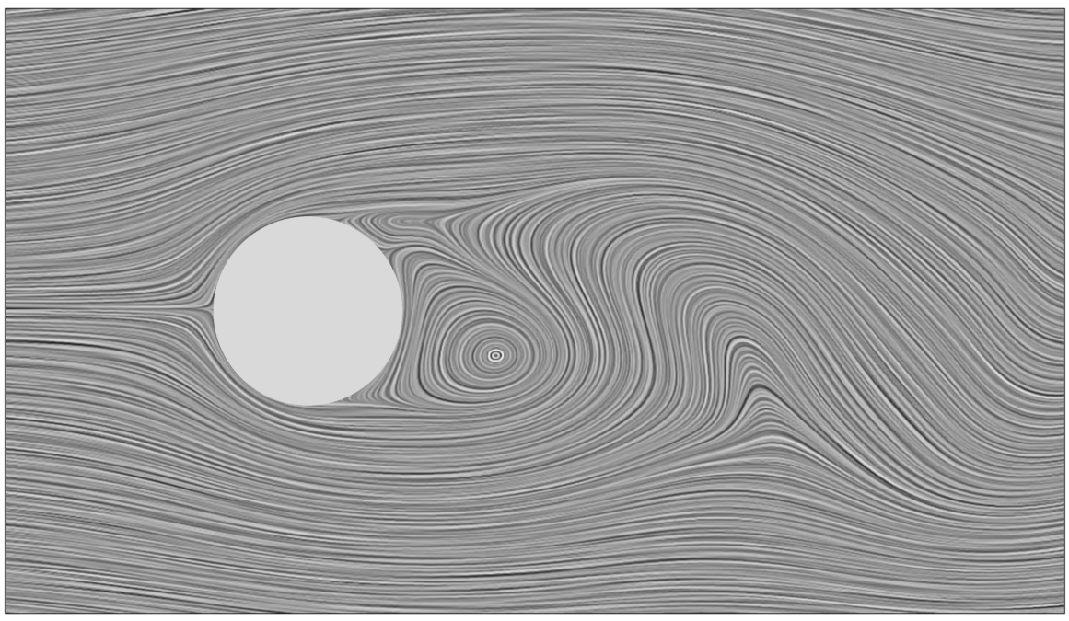
Line Integral Convolution
Filter length influences the quality of LIC images
filter length = 100
2D flow behind a cylinder
show example in Amira

Slide 36
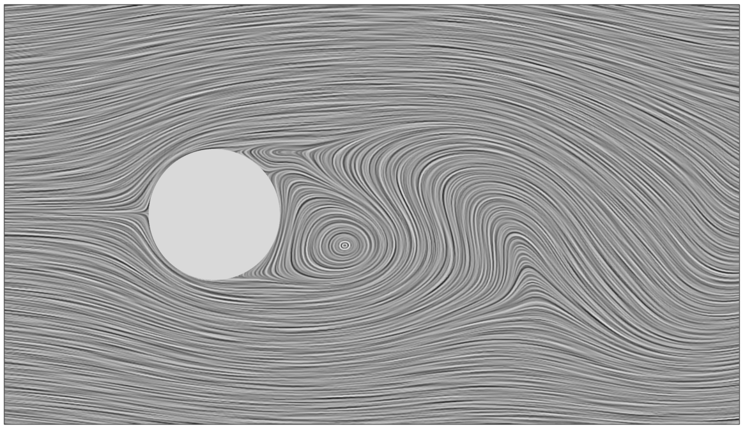
Line Integral Convolution
Filter length influences the quality of LIC images
filter length = 50
2D flow behind a cylinder

Slide 37
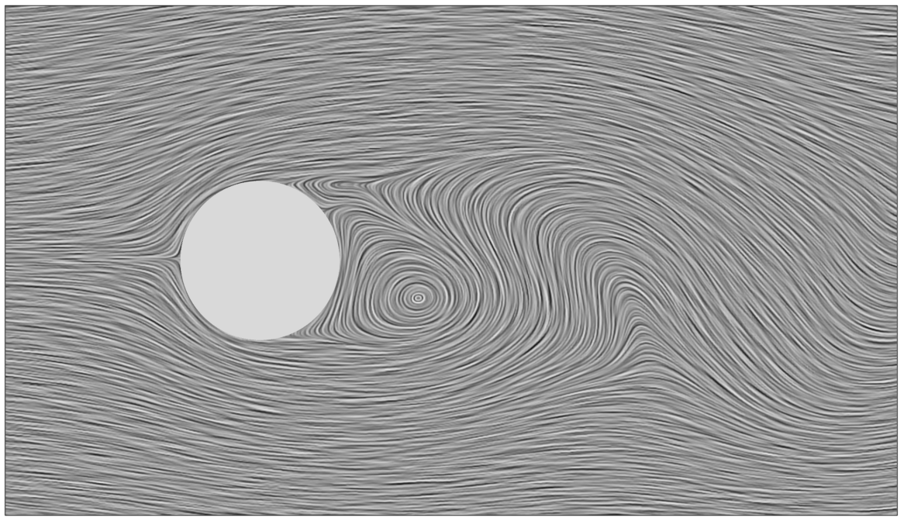
Line Integral Convolution
Filter length influences the quality of LIC images
filter length = 25
2D flow behind a cylinder

Slide 38
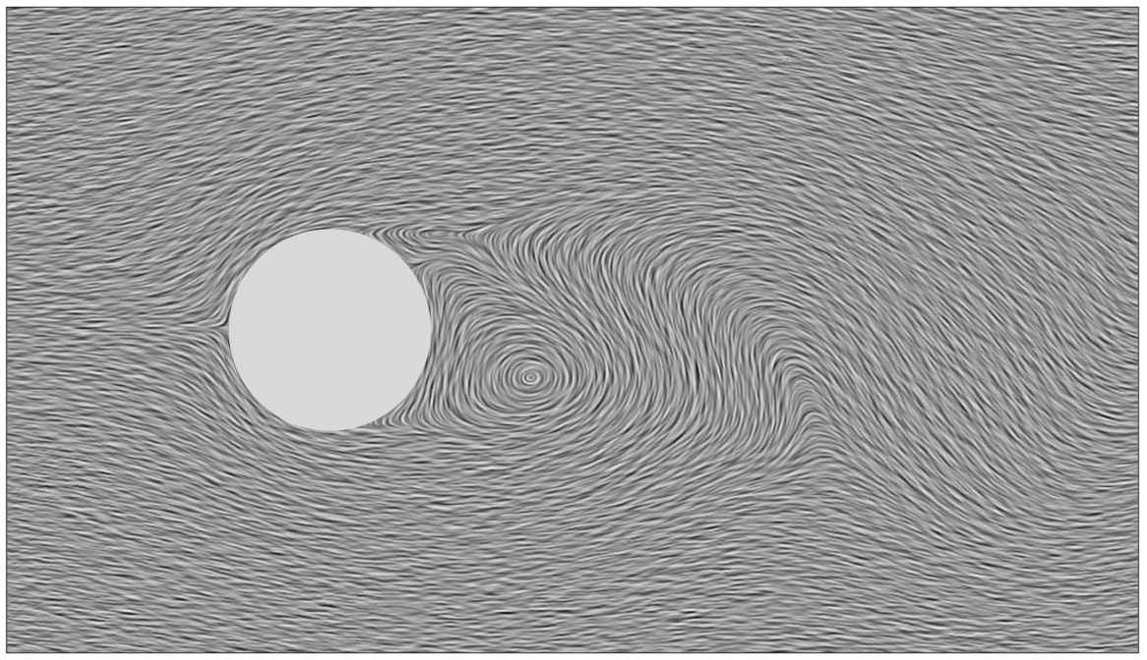
Line Integral Convolution
Filter length influences the quality of LIC images
filter length = 10
2D flow behind a cylinder

Slide 39
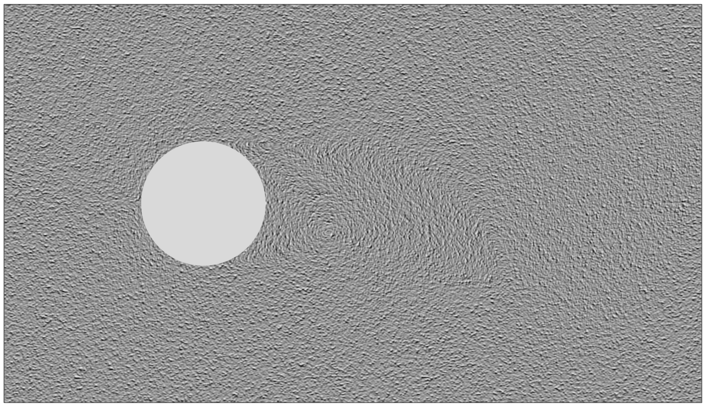
Line Integral Convolution
Filter length influences the quality of LIC images
filter length = 1
2D flow behind a cylinder

Slide 40
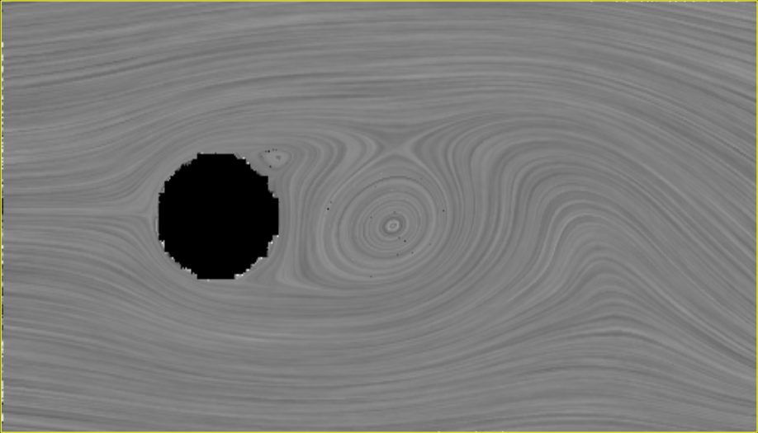
Line Integral Convolution
Technical details: Contrast
Problem: Convolution reduces contrast of the grayscale image
Solutions:
Use black-white image as input
Enhance contrast after convolution

Slide 41
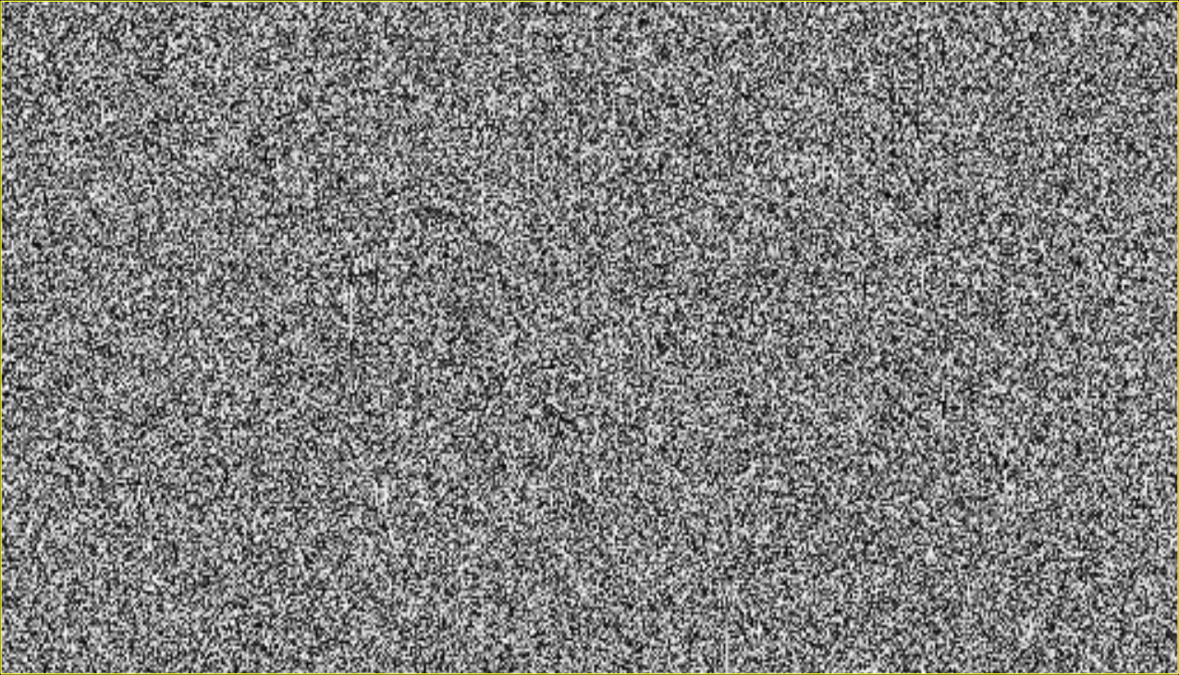
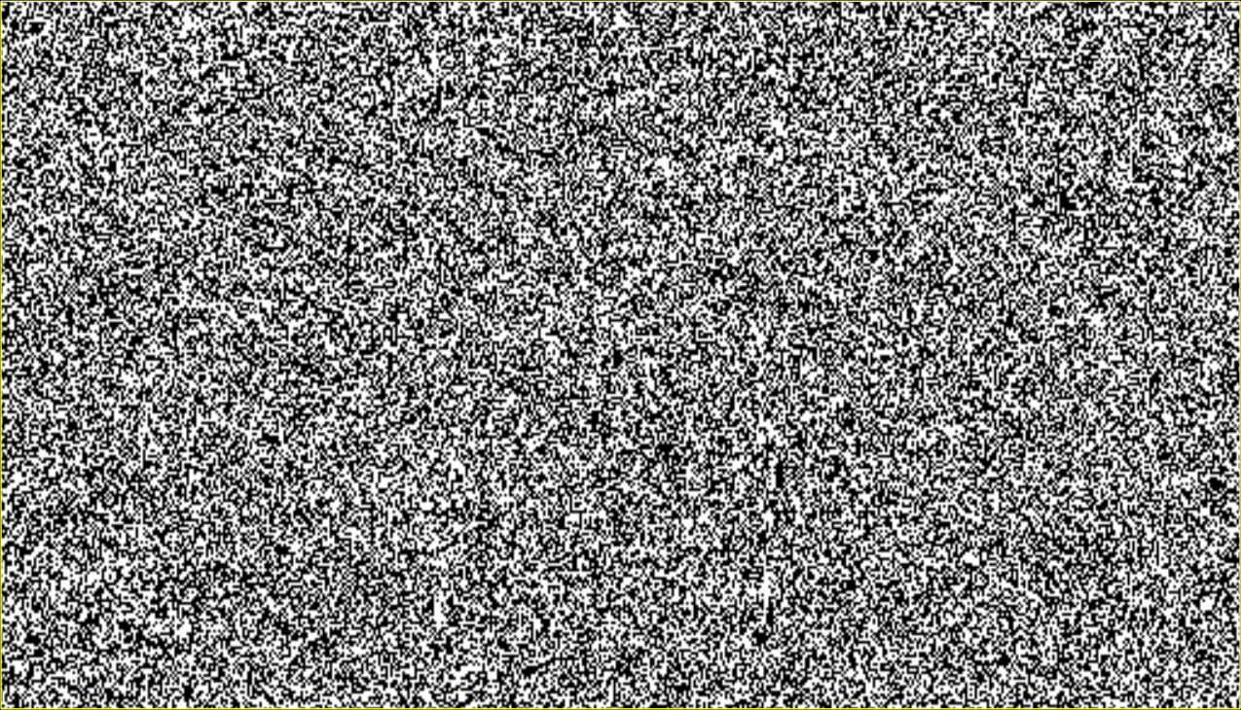
Line Integral Convolution
Technical details: Contrast
grayscale input texture
black-white input texture

Slide 42
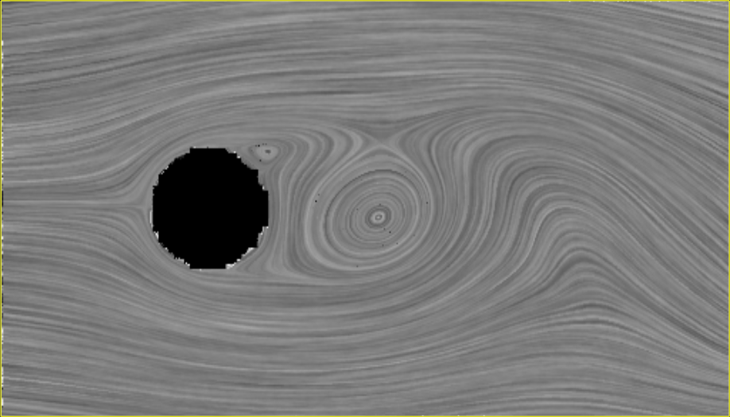
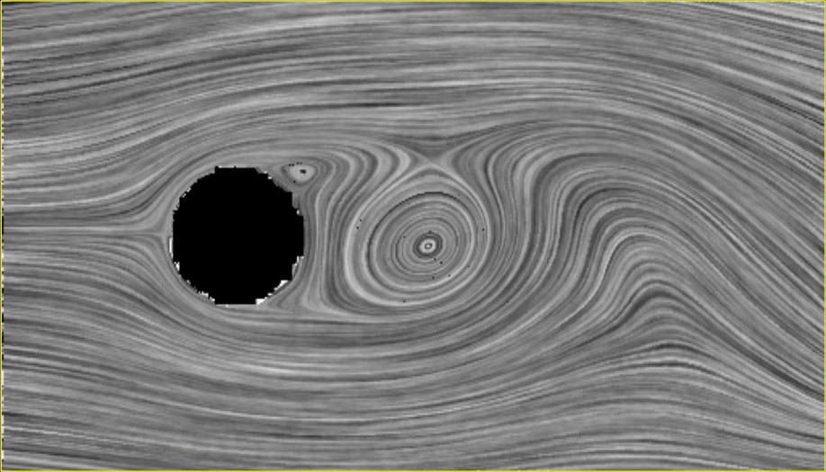
Line Integral Convolution
Technical details: Contrast
grayscale input texture
black-white input texture
enhanced contrast

Slide 43
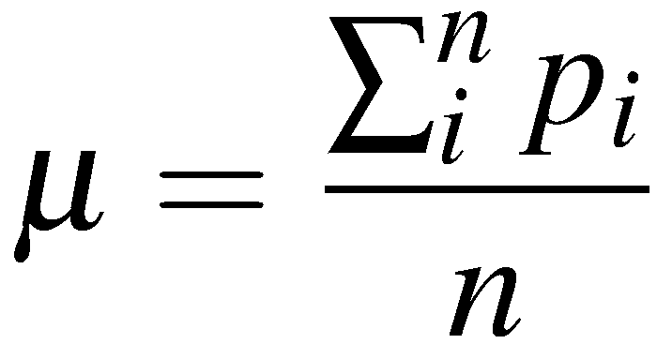
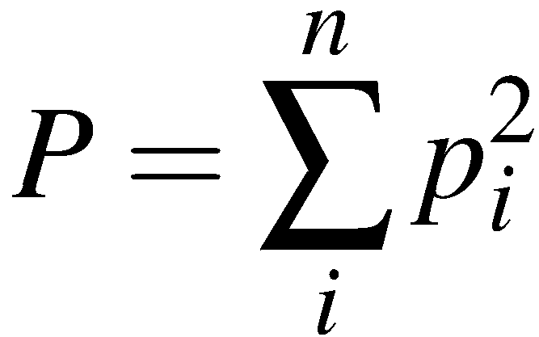
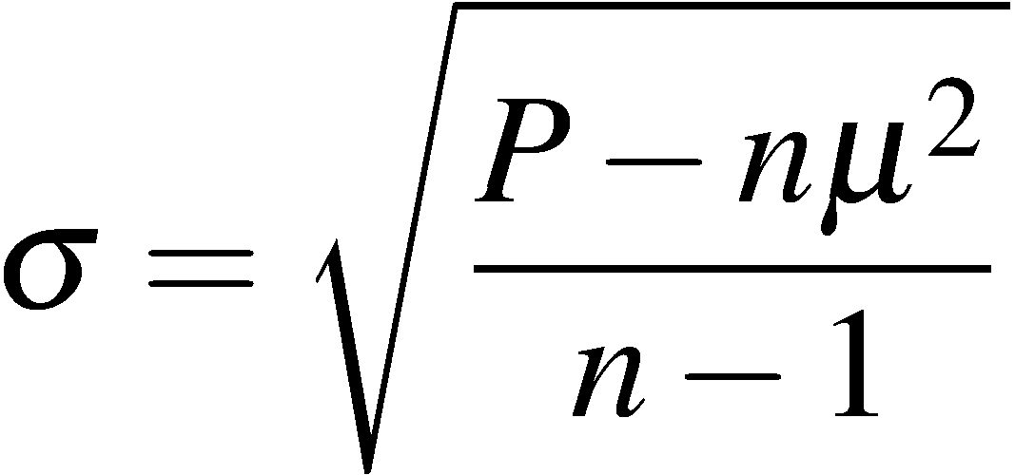
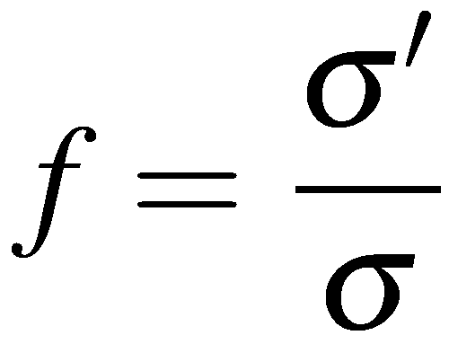
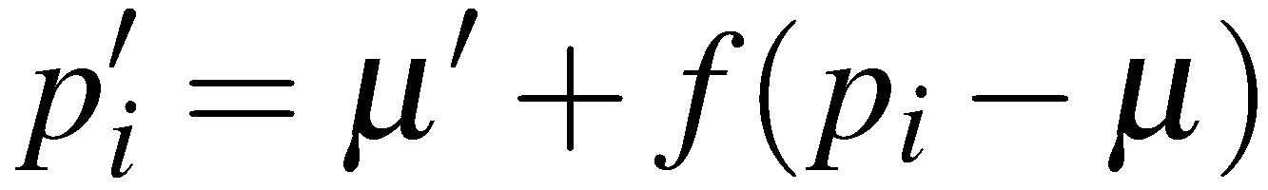
Line Integral Convolution
Technical details: Enhancing the contrast
Compute mean and standard deviation of the convolved texture
Adjust the mean and standard deviation to desired values
only for all non-black pixels !
arithmetic mean
standard deviation
stretching factor (restrict to a maximum value !)
new grayscale pixel values

Slide 44
Line Integral Convolution
Technical details: Enhancing the contrast
Good defaults for desired mean and standard deviation:
considering a range [0, 1] with 0=black and 1=white
mean ➔ 0.5
standard deviation ➔ 0.1

Slide 45
Line Integral Convolution
Technical details: Performance ➔ FastLIC
Fast Line Integral Convolution (FastLIC) Stalling/Hege 1995
➔ Increase performance of LIC
apply convolution on all pixels on a particular stream line
store all pixels for which convolution is carried out
for untouched pixel: start a new tangent curve from there
Significant speed up in comparison to original LIC
Current implementations of LIC follow these ideas instead of the original algorithm.
Notes:
45

Slide 46
Line Integral Convolution
Technical details: Performance ➔ FastLIC
General idea: exploit the coherence along the stream line
Classic LIC: Visit every pixel, Integrate stream line, Convolve
FastLIC: Visit every pixel that has not yet been visited Integrate stream line for as long as possible Convolve for every pixel covered by the stream line

Slide 47
Line Integral Convolution
Technical details: Performance ➔ FastLIC

Slide 48
Line Integral Convolution
Technical details: Performance ➔ FastLIC
Shifting the kernel: fast update possible for most kernels
Notes:
Show the fast update of the box kernel on the black board
We have two values: PixelSum and PixelNum
NewPixelSum = OldPixelSum – LeftValue + RightValue
NewPixelNum = OldPixelNum
Explain what to do at the boundary: Use the small kernel

Slide 49
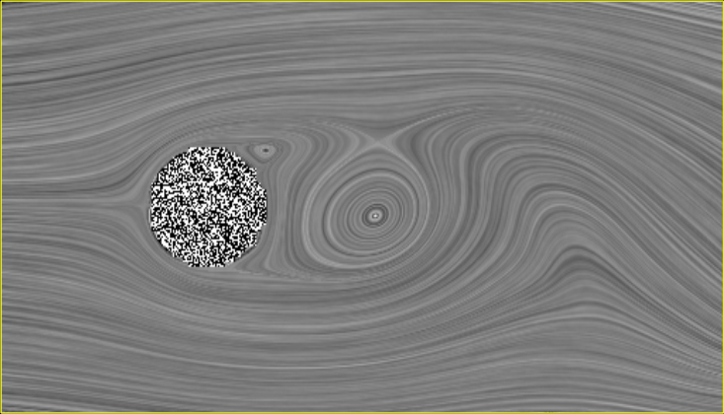
Line Integral Convolution
Technical details: Performance ➔ FastLIC
Significantly fewer stream lines required
Significantly better anti-aliasing
131072 stream lines were required to compute the classic LIC texture.
9 seconds for 512x256 texture.
6186 stream lines were required to compute the FastLIC texture.
<1 second for 512x256 texture.
Notes:
Show the fast update of the box kernel on the black board
We have two values: PixelSum and PixelNum
NewPixelSum = OldPixelSum – LeftValue + RightValue
NewPixelNum = OldPixelNum

Slide 50
Line Integral Convolution
Technical details: Reproducibility
Using a random texture makes it difficult to reproduce the result from a previous run of the program
➔ Initialize the random number generator using a seed.
The seed could be a parameter given by the user.
srand() is the corresponding C function.
Then, the same random texture is generated with each run of the program. Unless you change other parameters such as the size of the texture.

Slide 51
Flow Visualization: Image-Based Methods
LIC – Line Integral Convolution
Improving LIC in the following directions:
➔ combination with color coding
➔ special applications (motion blur…)
➔ adding flow orientation
➔ LIC on surfaces
➔ LIC for 3D flows
➔ LIC for unsteady flows
Notes:
51

Slide 52
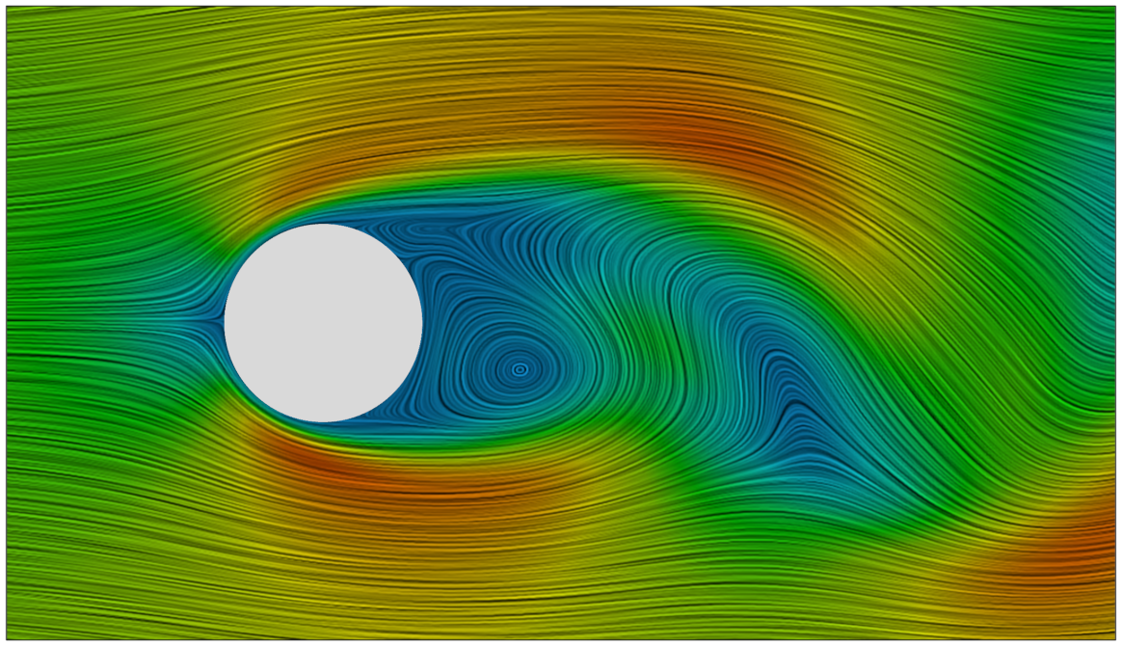
Flow Visualization: Image-Based Methods
LIC – Line Integral Convolution
Combination with color coding
Usually, LIC does not use the color channel
➔ Use color to encode scalar quantities
Velocity magnitude encoded using color
2D flow behind a cylinder
Notes:
What color model to use?
HSV = Hue Saturation Value
Value ➔ LIC Grayscale Value
Hue ➔ encodes magnitude or other scalar field
Saturation ➔ constant

Slide 53
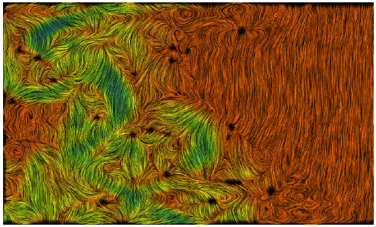
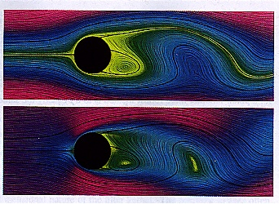
Line Integral Convolution
LIC and color coding of velocity magnitude

Slide 54
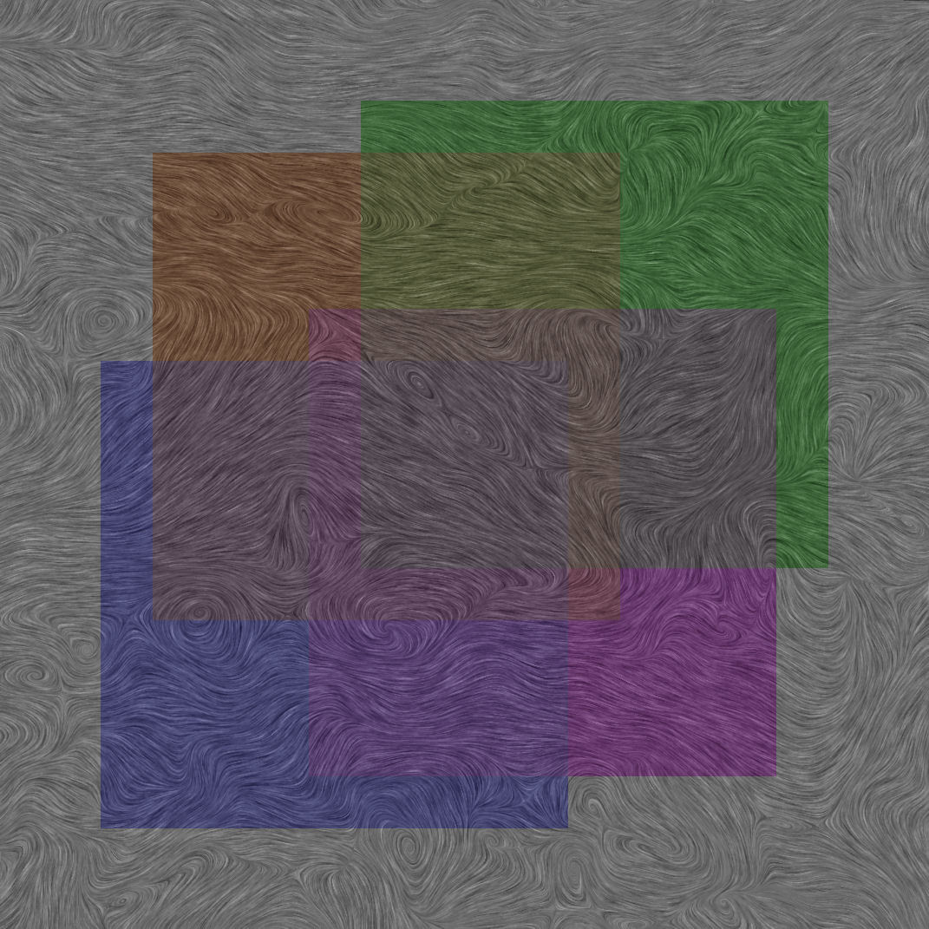
Flow Visualization: Image-Based Methods
Color Weaving (Urness et al., Vis 2003)
How to encode different scalar quantities in a single LIC image?
Four artificially defined, mutually overlapping regions, overlaid on a LIC image. The color combinations in the overlap regions are obtained by averaging in RGB colorspace.

Slide 55
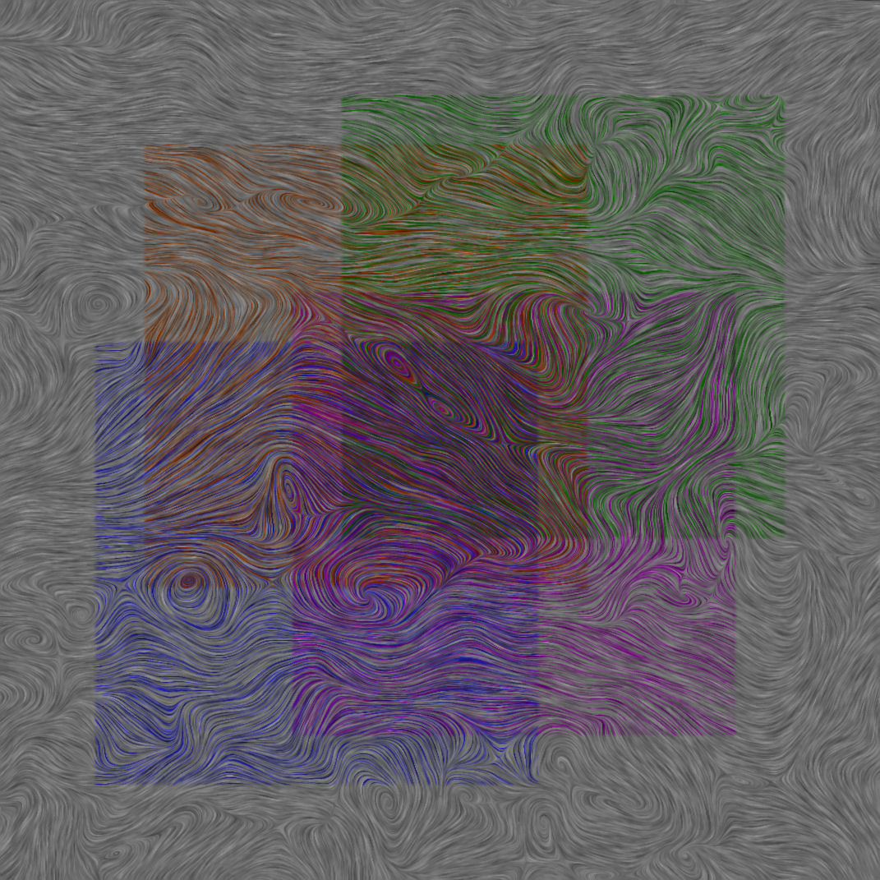
Flow Visualization: Image-Based Methods
Color Weaving (Urness et al., Vis 2003)
How to encode different scalar quantities in a single LIC image?
The same four regions, represented across the same LIC image via color weaving. Note the continuity of color along individual streamlines within each region, and the ability to accurately perceive combinations of component colors in the areas of high overlap (characterized by the presence of three or more
layers).

Slide 56



Flow Visualization: Image-Based Methods
Color Weaving (Urness et al., Vis 2003)
Idea: Visualize multi-variate data on top of LIC by encoding different scalar quantities into the color of neighboring stream lines
Close-ups

Slide 57

Flow Visualization: Image-Based Methods
Color Weaving (Urness et al., Vis 2003)
5 base colors; highly saturated and perceptually iso-luminant
Select colors that are easy to discriminate
Create two-dimensional color maps:
Vary saturation along horizontal axis
Vary value along vertical axis
saturation
value

Slide 58
Flow Visualization: Image-Based Methods
Color Weaving (Urness et al., Vis 2003)
Each scalar quantity gets its own colormap
Final pixel color:
Hue: scalar quantity to be encoded, i.e., its colormap
Value: gray value obtained from LIC
Saturation: value of the scalar quantity
One has to be careful when several stream lines run across the same pixel

Slide 59


Slide 60

Line Integral Convolution
Here, the chosen vector field is the gradient field of the image.

Slide 61

Line Integral Convolution
Add motion blur by means of variable length LIC

Slide 62

Line Integral Convolution
Length of convolution integral with respect to magnitude of vector field

Slide 63


Line Integral Convolution
Oriented LIC (OLIC):
Visualizes orientation (in addition to direction)
Uses a sparse texture, i.e., smearing of individual drops
Asymmetric convolution kernel
1
anisotropic
convolution
kernel
-L
L

Slide 64



Line Integral Convolution
Oriented LIC (OLIC)

Slide 65

Flow Visualization: Image-Based Methods
LIC on Surfaces
2 possibilities:
Integrate on surfaces
Integrate in image space
Show in Amira
Notes:
65

Slide 66


LIC on Surfaces
3D object
space
Generate
flow texture
Project
Image plane
Eye

Slide 67
LIC on Surfaces
3D object
space
Generate
flow texture
Project
Project
Generate
Image plane
Image plane
flow texture
Eye
Eye

Slide 68

Silhouette Lines

Slide 69

Rendering
No surface shading

Slide 70

Rendering
Gray surface

Slide 71

Rendering
Cool/warm shading for surface

Slide 72

Rendering
Gray surface Yellow/blue flow

Slide 73

Flow Visualization: Image-Based Methods
LIC for 3D Flows
LIC concept easily extendable to 3D
Problem: rendering!
3D LIC can only reveal interesting structures, if some data is discarded.
Notes:
73

Slide 74

3D LIC
Dense Noise
Sparse Noise

Slide 75
3D LIC Rendering
Scalar Volume Rendering via
Slice Based Volume Rendering
Raycasting
see Lecture on Volume Rendering

Slide 76


Flow Visualization: Image-Based Methods
3D LIC volume is explored by interactively moving a clip plane
(from Rezk et al 97)
3D LIC using volume rendering (from Interrante 97)
Notes:
76

Slide 77

Flow Visualization: Image-Based Methods
Use scalar quantities such as vorticity magnitude to define opacity for the final rendering.
Notes:
77

Slide 78

Flow Visualization: Image-Based Methods
LIC for unsteady flows:
UFLIC [Shen, Kao 97]
convolution along path lines (instead of stream lines)
Notes:
78

Slide 79


Flow Visualization: Image-Based Methods
Comparison of LIC and Spot Noise:
Spot noise: better encoding of velocity (magnitude)
LIC: better encoding of critical points
Spot noise
LIC
Notes:
79

Slide 80
Flow Visualization: Image-Based Methods
Texture advection
Based on moving (groups of) texels (texture elements)
Classification by
Advection scheme: forward / backward
Advection primitive: texel / textured polygon
Backward integration:
To get pixel color, integrate backwards over a certain time, get color from there
Iteration: backward integration / update
usually comes with GPU implementation
Notes:
80

Slide 81

Flow Visualization: Image-Based Methods
Notes:
81

Slide 82

Flow Visualization: Image-Based Methods
Notes:
82

Slide 83

Flow Visualization: Image-Based Methods

Slide 84

Flow Visualization: Image-Based Methods

Slide 85

Flow Visualization: Image-Based Methods

